Slide 1
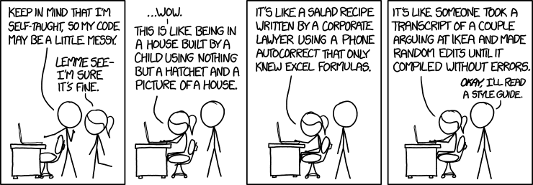
XKCD
Style guide

Slide 2
How much have you used R before today?
I use it regularly.
I have taken a course in R.
I have learned some R on my own.
Just a little bit.
Today is my first R experience.

Slide 3
Do you program in other languages?
C/C++
Java
Javascript
Python
SAS
SPSS
SQL
Other

Slide 4
How well do you know Excel?
Expert user
Skilled user
Intermediate user
Novice user
Never use it

Slide 5
Which statistical methods have you used?
Summary stats: mean, std dev …
Regression models
Descriptive charts and maps
Spreadsheets with calculated values
Statistics packages: SAS, SPSS, Minitab …
Other
None

Slide 6
What is R?
R is a programming language written by and for statisticians.
Initially developed by Robert Gentleman and Ross Ihaka at University of Auckland based on the S language from Bell Labs.
Free, open source
R offers powerful tool for interactive data analysis with many built-in statistical functions.
R contains graphical facilities for visualizing, reporting analysis and display either directly at the computer or on hardcopy
R supports reporting methods through which both analytic results and the steps taken to produce the results are delivered as an integrated unit,
R is being constantly augmented by a large community of contributors who develop packages that extend the functionality of R to support cutting edge research.

Slide 7
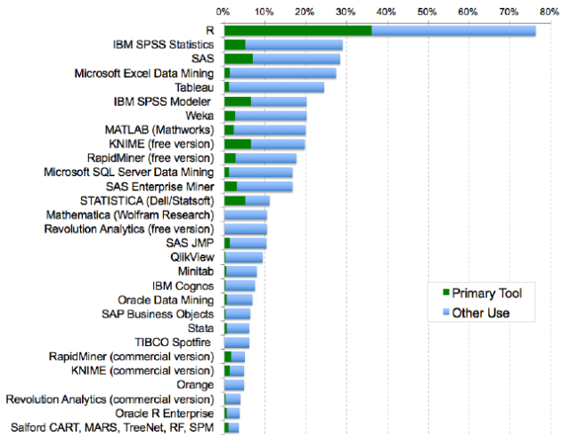
R is the tool of choice
Analytics tools used by respondents to the 2015 Rexer Analytics Survey. In this view, each respondent was free to check multiple tools.
Source: RA. Muenchen, 2016:
http://r4stats.com/articles/popularity/

Slide 8
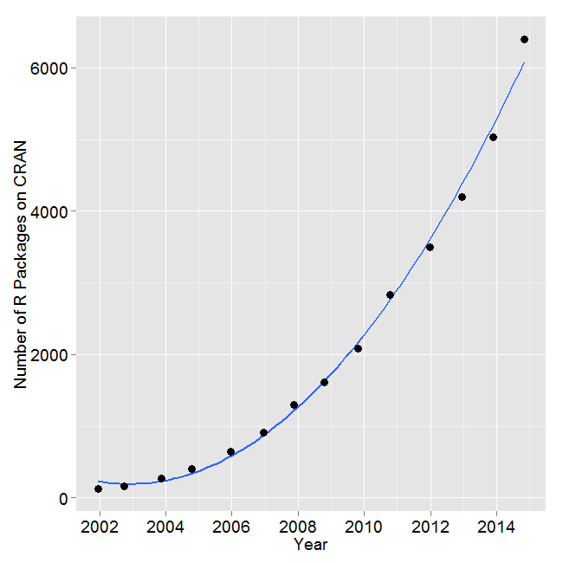
R Packages deliver functionality
Number of R packages available on its main distribution site for the last version released in each year.
List of R Packages
Many statistical researchers provide their methods as R packages.
Source: RA. Muenchen, 2016:
http://r4stats.com/articles/popularity/

Slide 9
The R Community
Resources to support R users and extend the applications of R
CRAN: The Comprehensive R Archive Network
R: The R Project for Statistical Computing
R-Bloggers
DataCamp: The Easy Way To Learn R & Data Science Online
R for Everyone « Jared Lander
Welcome · Advanced R.
FlowingData
ggplot2
Cookbook for R
Welcome · R packages
RStudio – Open source and enterprise-ready professional software for R
ggvis 0.4 overview

